Slide 1
Diabetes Analysis and Prediction Report
CAPSTONE PROJECT - Andrew Soon Ng

Slide 2
Data Preparation / Exploration
Basic Information
Dataset source -https://www.kaggle.com/code/alexteboul/diabetes-health-indicators-dataset-notebook/input
Background understanding - The Behavioral Risk Factor Surveillance System (BRFSS)
Data Understanding - 2015 Codebook Report
Dataset review and analysis
Data Selection – Year 2015, latest in the records.
Data Cleaning
From 400K records to 250K records
From 330 Columns to 22 Columns
Data preprocessing
Define Positive (value = 1) and Negative (value = 0) value for the data
Data exploratory analysis
Analyst Data including the correlation of features/columns
Outputs – prepare data for modeling
Cleaned dataset with original diabetes status
Positive, Negative & prediabetes
Cleaned dataset with binary diabetes status.
Positive & Negative (converted prediabetes to negative)
Cleaned dataset with 50% balanced outcome
Added 40K random record for non-diabetes

Slide 3
Prediction Modeling
Model Development (Binary Diabetes Dataset)
Random Forest
Accuracy – 85%
Logistic Regression
Accuracy – 87%
KNN for Classification
Accuracy – 85%
Train Test Split
Test sample selection – 20%
Correlation Heatmap Review
Features Selection
15 correlate features selected for prediction.
HighBP, HighChol, BMI, Stroke, HeartDiseaseorAttack, PhysActivity, HvyAlcoholConsump, AnyHealthcare, GenHlth, PhysHlth, DiffWalk, Sex, Age, Education, Income
Prediction
User Interface for collection user input.
Prediction Output

Slide 4
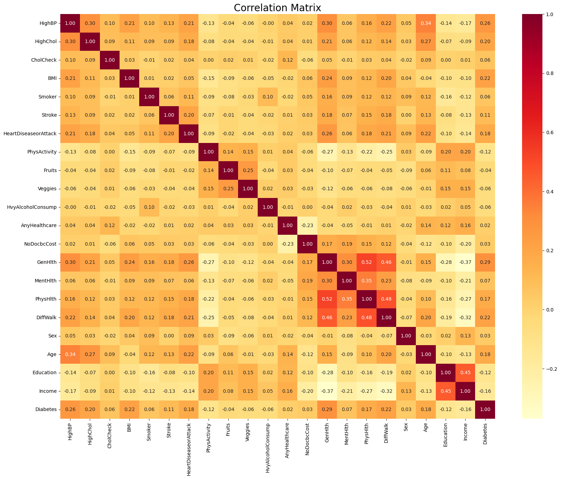
Correlation Matrix

Slide 5
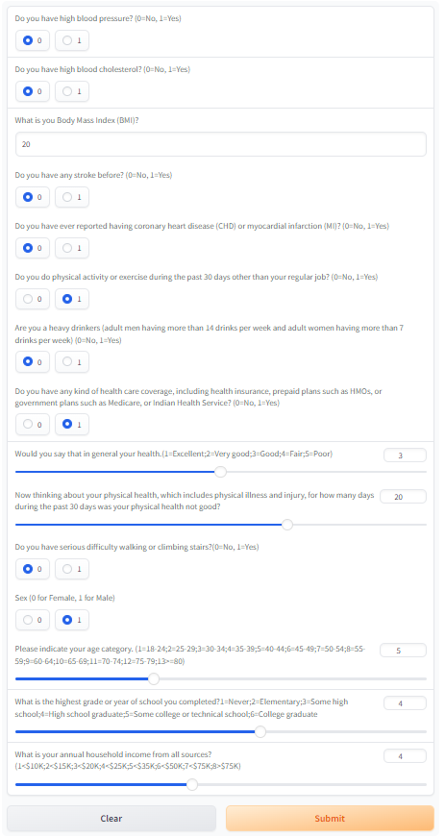
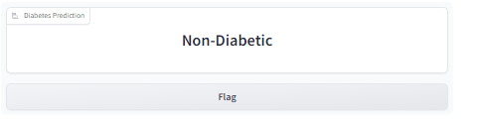
User Input & Prediction

Slide 6
Diabetes Analysis and Prediction Quality Assurance & Testing
CAPSTONE PROJECT - Andrew Soon Ng

Slide 7
Quality Assurance & Testing
Test Samples Generation
Number of features = 15
Maximum Combinations =1,246,003,200 (stopped at 12 GB)
Modified Combinations = 663,552
BMI – 3 values selected (15, 25 & 35)
GenHlth – 3 values selected (1, 3 & 5)
PhysHlth – 4 values selected (1, 10, 20 & 30)
Age – 4 values selected (1, 5, 9 & 13)
Income – 3 values selected (1, 4 & 8)
Verification
Manual Inspection Samples – 10% (66,356 records)
Model Tested
Random Forest
Positive Prediction – 3.4%
Logistic Regression
Positive Prediction – 4.3%
KNN for Classification
Positive Prediction – 9.2%
Next Step
Medical Professional to perform random sampling verification on 10% samples.

Slide 8
Test Samples
Features | Number Of possible values | Number of Test values
"HighBP" | 2 | 2
"HighChol" | 2 | 2
"BMI" | 26 | 3
"Stroke" | 2 | 2
"HeartDiseaseorAttack" | 2 | 2
"PhysActivity" | 2 | 2
"HvyAlcoholConsump" | 2 | 2
"AnyHealthcare" | 2 | 2
"GenHlth" | 5 | 3
"PhysHlth" | 30 | 4
"DiffWalk" | 2 | 2
"Sex" | 2 | 2
"Age" | 13 | 4
"Education" | 6 | 3
"Income" | 8 | 3
Number of Test Record | 1,246,003,200 | 663,552
Stopped at 12GB

Slide 9
Diabetes Analysis and Prediction Proposal
CAPSTONE PROJECT - Andrew Soon Ng

Slide 10
Diabetes Analysis and Prediction
Background and Motivation:
Diabetes is a chronic disease affecting millions of people worldwide, and early detection is crucial for effective management. The Diabetes Health Indicators Dataset, available on Kaggle, provides comprehensive data on various health indicators such as physical activity, BMI, blood pressure, and more, all of which are crucial in assessing diabetes risk. Using this dataset, machine learning techniques can be employed to predict the likelihood of diabetes, enabling more effective prevention strategies and healthcare interventions.
Project Objectives:
To develop a predictive model using machine learning algorithms to identify individuals at high risk of diabetes.
To analyze the key health indicators contributing to diabetes risk.
To evaluate the performance of different models (e.g., logistic regression, decision trees, random forests, etc.) for accuracy and interpretability.
Personal objectives of this project including:
Learning the end-to-end process/steps to perform analysis on data provided
Learning the tools/approaches/methods for working on data analysis.

Slide 11
Diabetes Analysis and Prediction
Dataset Source
https://www.kaggle.com/code/alexteboul/diabetes-health-indicators-dataset-notebook/input
Data overview
The Behavioral Risk Factor Surveillance System (BRFSS) is the nation's premier system of health-related telephone surveys that collect state data about U.S. residents regarding their health-related risk behaviors, chronic health conditions, and use of preventive services. Established in 1984 with 15 states, BRFSS now collects data in all 50 states as well as the District of Columbia and three U.S. territories. BRFSS completes more than 400,000 adult interviews each year, making it the largest continuously conducted health survey system in the world.
The objective of the BRFSS is to collect uniform, state-specific data on preventive health practices and risk behaviors that are linked to chronic diseases, injuries, and preventable infectious diseases in the adult population. Factors assessed by the BRFSS include tobacco use, health care coverage, HIV/AIDS knowledge or prevention, physical activity, and fruit and vegetable consumption. Data are collected from a random sample of adults (one per household) through a telephone survey. 2015 dataset was selected for this project, which contains over 441,000 records with 330 columns. After the data cleaning and preprocessing phase, only 250,000 records with 22 columns representing various health-related attributes such as:
Age, Gender, and BMI.
Smoking and Alcohol Consumption.
Physical Activity, Diet, and Blood Pressure.
Previous Medical History (e.g., stroke, heart attack).
Diabetes Status (binary target variable).

Slide 12
Methodology
Data Cleaning and Preprocessing
Handle missing values, outliers, and normalize the data for effective model training. References: Behavioral Risk Factor Surveillance System 2015 Codebook Report
Exploratory Data Analysis (EDA)
Perform EDA to understand the distribution of variables and their relationships with diabetes risk.
Feature Engineering
Generate new features from existing data (e.g., interaction terms between BMI and physical activity).
Model Development
Build and train multiple machine learning models, including logistic regression, decision trees, and ensemble methods such as random forests.
Model Evaluation
Use accuracy, precision, recall, F1-score, and ROC-AUC to evaluate model performance.
Quality Assurance Testing (Additional)
Generate all possible combination for testing
Test with model to collect result
10% data for manual checking

Slide 13
Expected Outcomes
A high-performing machine learning model capable of accurately predicting the risk of diabetes.
Identification of the most influential health indicators in determining diabetes risk.
Insights that can guide healthcare professionals in prioritizing prevention and intervention efforts.

Slide 14
Timeline
Week 1
Data cleaning, preprocessing, and exploratory analysis.
Week 2
Model development and tuning.
Week 3
Model evaluation and comparison.
Week 4
Report generation and final model deployment.

Slide 15
Tools And Technologies
Python
Libraries such as Pandas, Scikit-learn, and Matplotlib.
Kaggle
Dataset hosting and project collaboration.
Microsoft Studio
Code execution and documentation.

Slide 16
Tools And Technologies
Python
Libraries such as Pandas, Scikit-learn, GRadio Interface and Matplotlib.
Kaggle
Dataset hosting and project collaboration.
Microsoft Studio
Code execution and documentation.

Slide 17
Backup Charts

Slide 18
Output of Random Forest Model Evaluation
 | precision | recall | f1-score | support
0.0 | 0.88 | 0.96 | 0.92 | 43739
1.0 | 0.43 | 0.20 | 0.27 | 6997
accuracy |  |  | 0.85 | 50736
macro avg | 0.66 | 0.58 | 0.59 | 50736
weighted avg | 0.82 | 0.85 | 0.83 | 50736

Slide 19
Output of Logistic Regression Model Evaluation
 | precision | recall | f1-score | support
0.0 | 0.88 | 0.98 | 0.93 | 43739
1.0 | 0.54 | 0.17 | 0.25 | 6997
accuracy |  |  | 0.87 | 50736
macro avg | 0.71 | 0.57 | 0.59 | 50736
weighted avg | 0.83 | 0.87 | 0.83 | 50736

Slide 20
Output of KNN Model Evaluation
 | precision | recall | f1-score | support
0.0 | 0.88 | 0.95 | 0.92 | 43739
1.0 | 0.41 | 0.20 | 0.27 | 6997
accuracy |  |  | 0.85 | 50736
macro avg | 0.66 | 0.58 | 0.59 | 50736
weighted avg | 0.82 | 0.85 | 0.83 | 50736

Slide 21
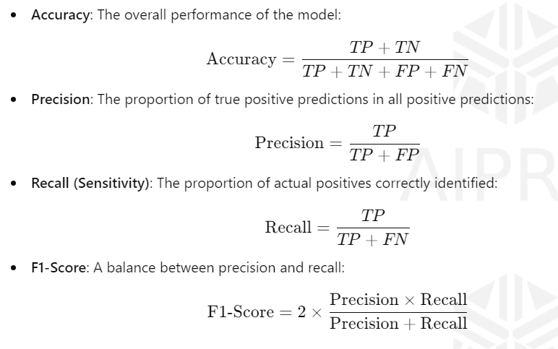
Model Evaluation

